Slide 1
Java EE: Java Server Pages
INTRODUCTION

Slide 2
JSP Server Pages
JSP Fundamentals
JSP Built-in Objects
Handling Exceptions in JSP
Working with Standard Actions
JSP Standard Tag Library & Custom Tag
Session Handling

Slide 3

Module Overview
JSP Life Cycle
JSP Development Models

Slide 4
Prerequisite
Servlets

Slide 5
JSP Life Cycle

Slide 6
What is JSP ?
Java Server Pages is a technology that helps software developers to create platform independent dynamic web application rapidly based on HTML or XML document types.

Slide 7
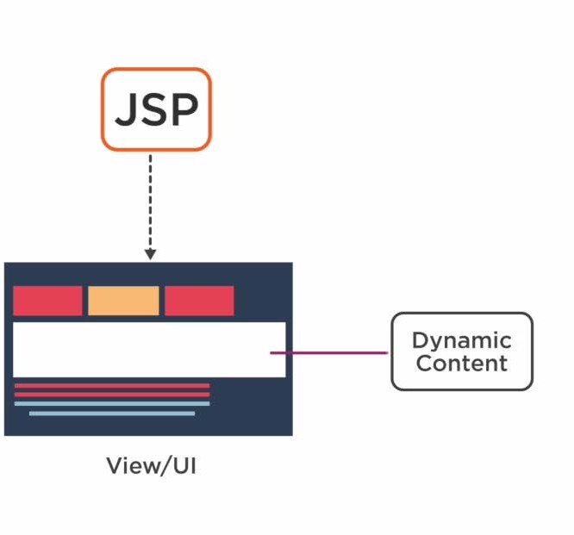

Slide 8


Slide 9
Requires strong knowledge of Java
Writing HTML code will be difficult Need to recompile & redeploy
Limitations of
Servlets

Slide 10
Not mandatory to have strong programming knowledge of Java
Writing HTML code is easy
Modifications are recognized Programs can use standard tags
Easy to learn, implement and maintain
Advantages Of
Using JSP

Slide 11
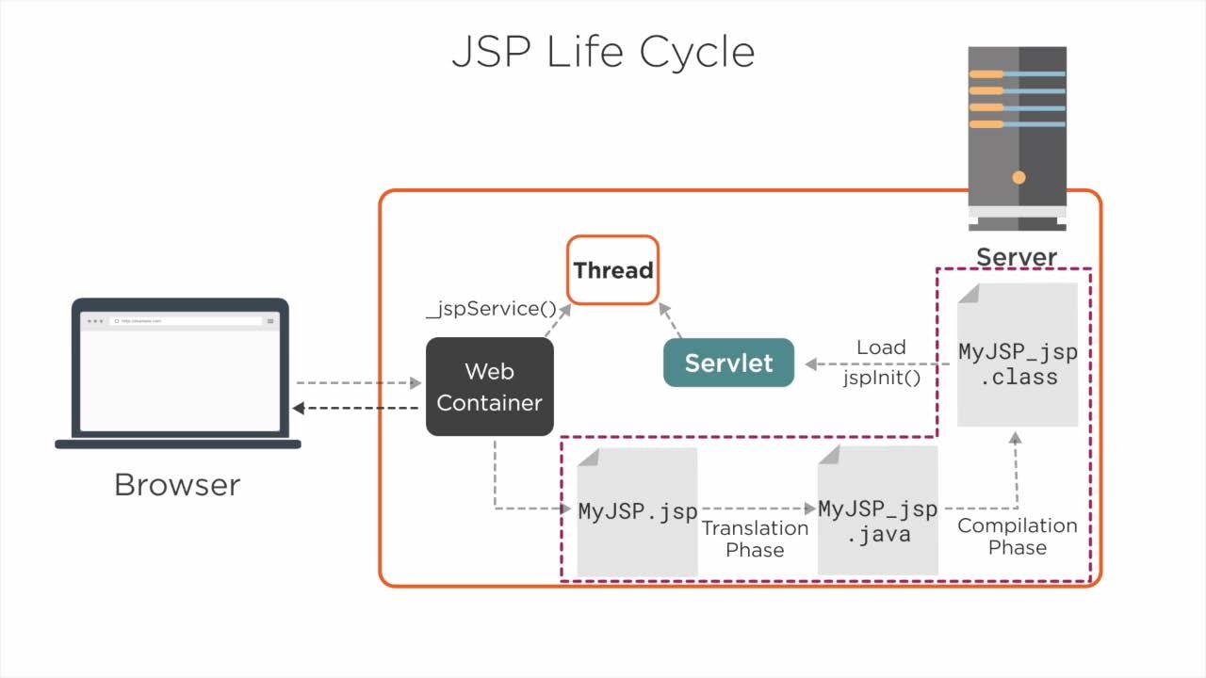

Slide 12
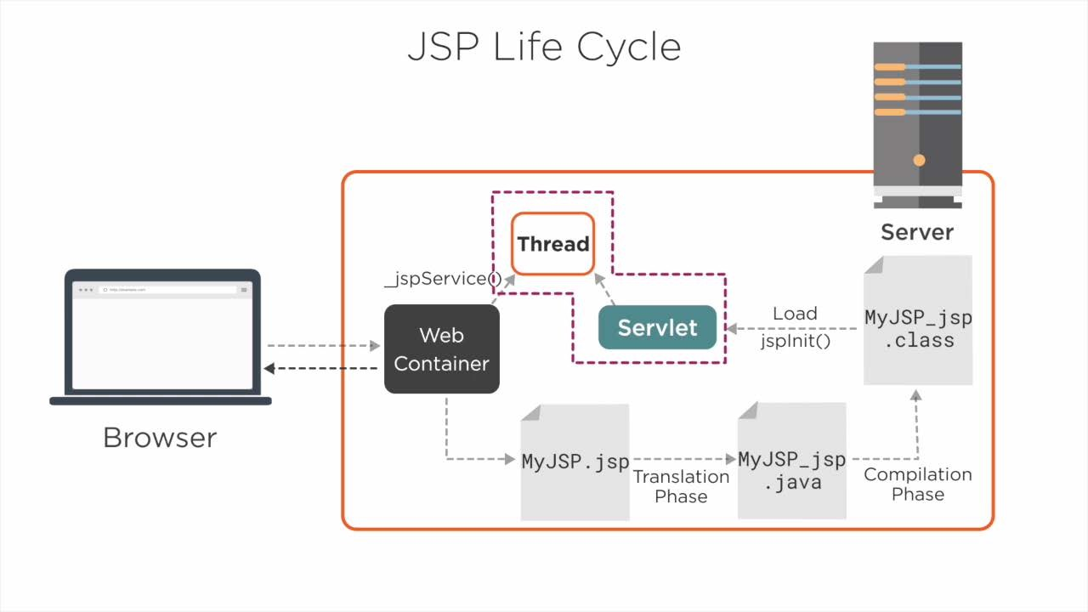

Slide 13
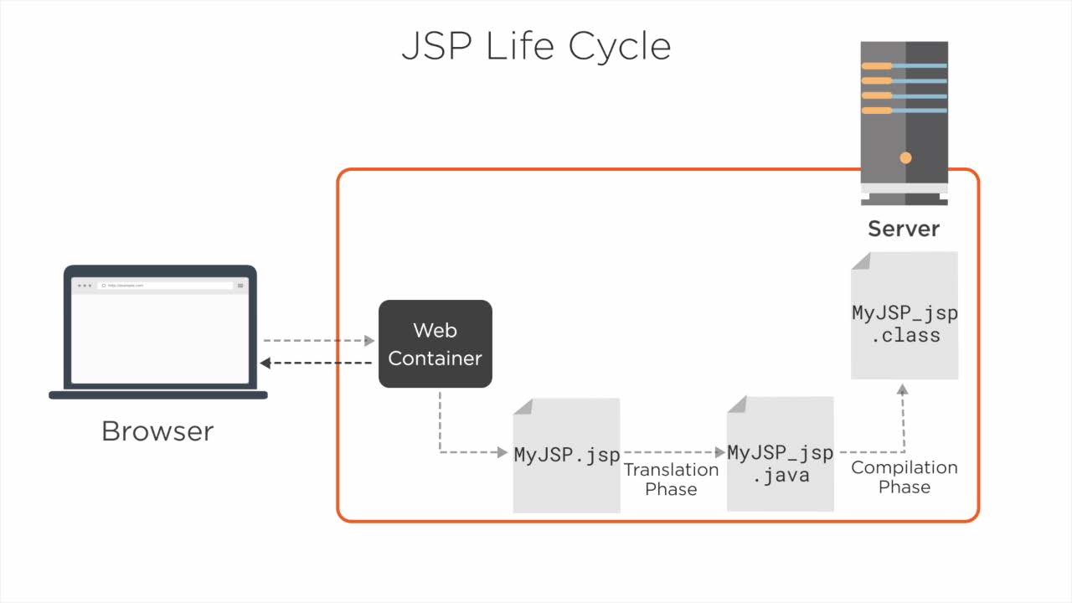

Slide 14
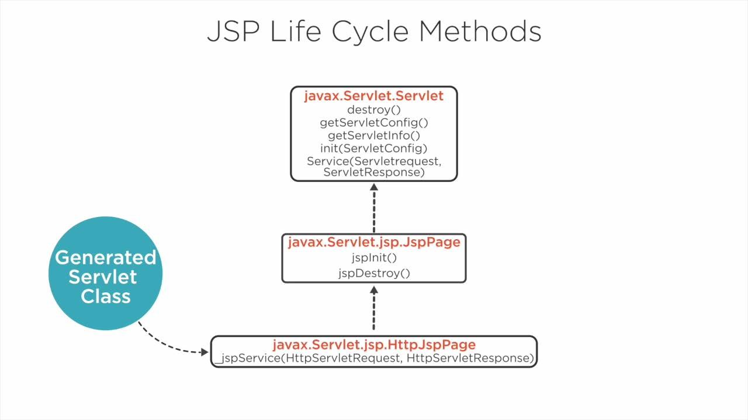

Slide 15
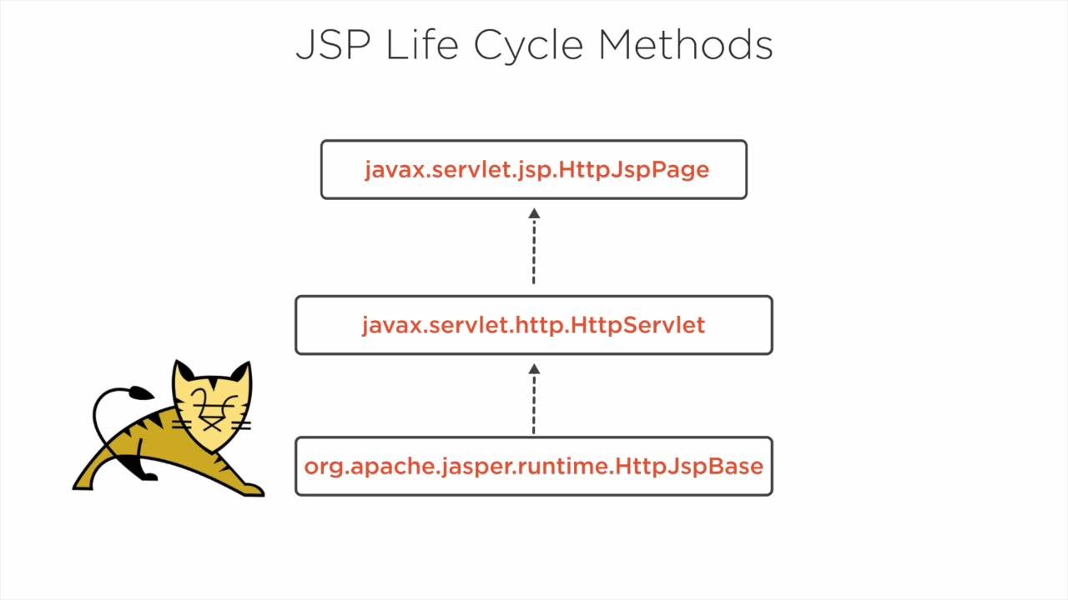

Slide 16
JSP Development Models

Slide 17
Development
Models
Model 1 Architecture
Model 2 Architecture

Slide 18
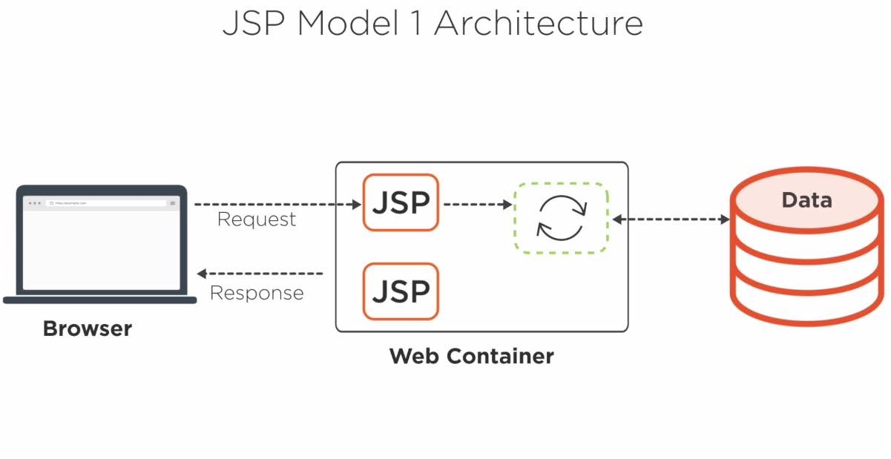

Slide 19
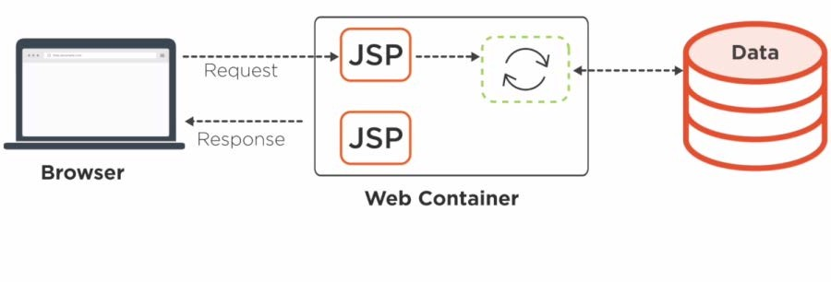
JSP Model 1 Architecture
Pros:
Development will be easy and faster Cons:
Not suitable for large-scale application development
No Separation of Concerns Maintenance will be problem

Slide 20
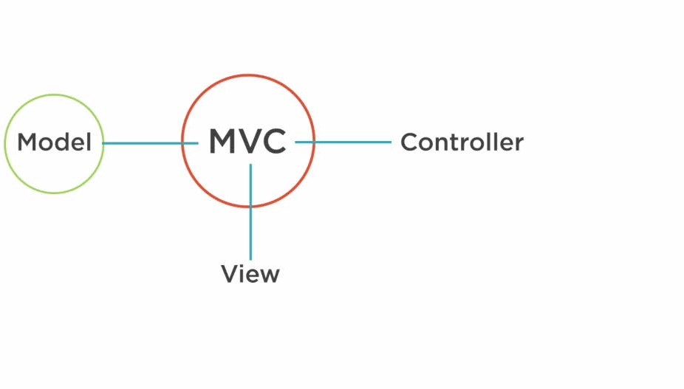
JSP Model 2 Development Architecture

Slide 21
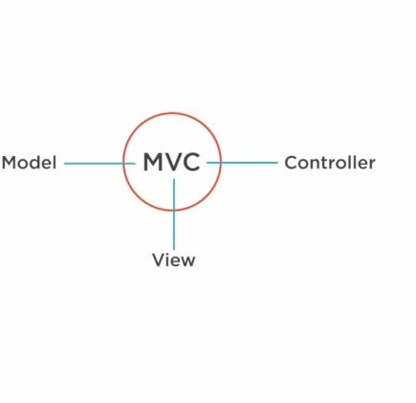
Model 2 Development Architecture
Using MVC 1 Architecture
Using MVC 2 Architecture

Slide 22
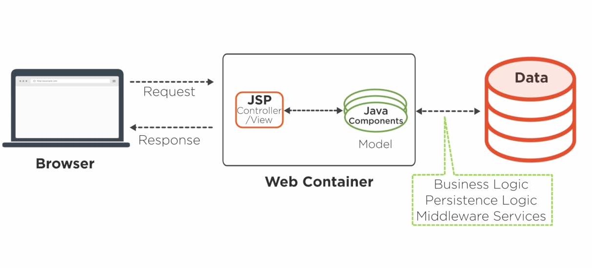
JSP Model 2 Architecture –MVC 1

Slide 23
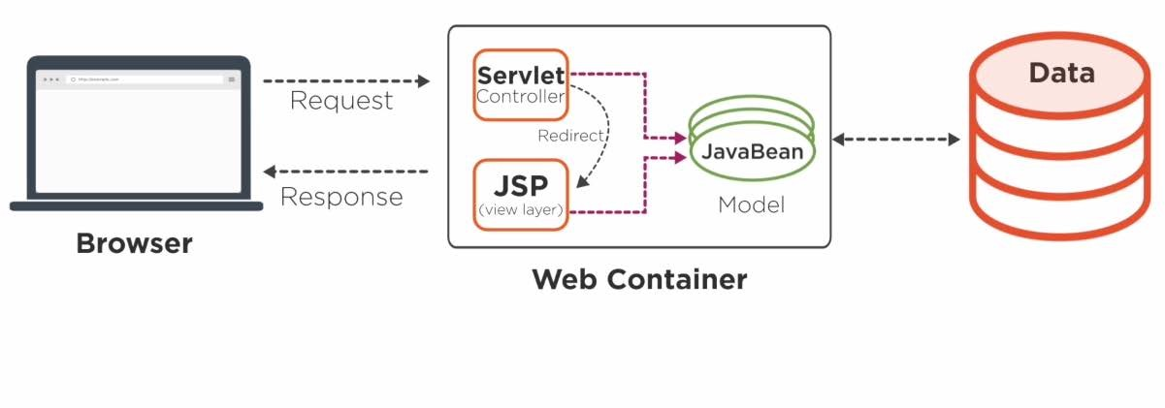
JSP Model 2 Architecture –MVC 2

Slide 24
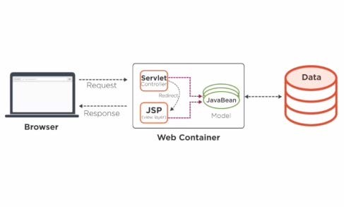
JSP Model 2 Architecture-MVC 2
Pros:
Navigation Control Centralized Follows Industry Standard Easy to Maintain
Better Separation Of Concern Parallel Development
Cons :
Need to Recompile the Servlet Class

Slide 25
Course Outline

Slide 26
Development
Models
Model 1 Architecture
Model 2 Architecture

Slide 27
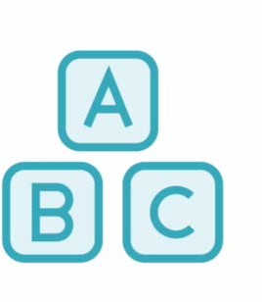
Expression Tag
Declaration Tag Scriptlet Tag

Slide 28
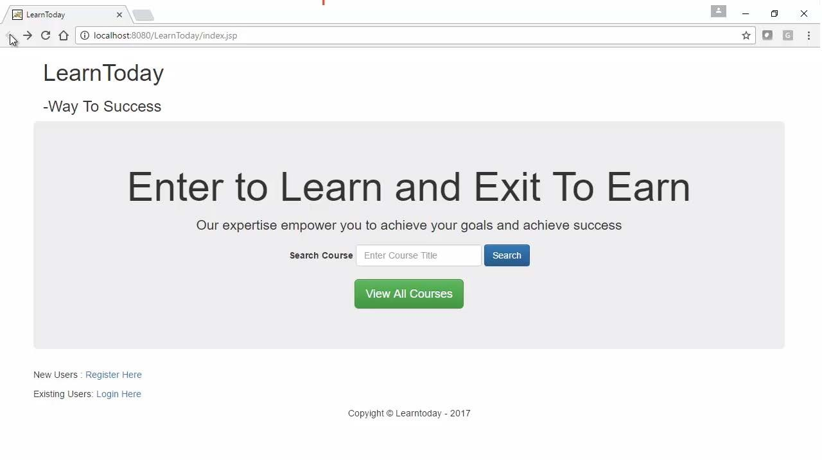

Slide 29
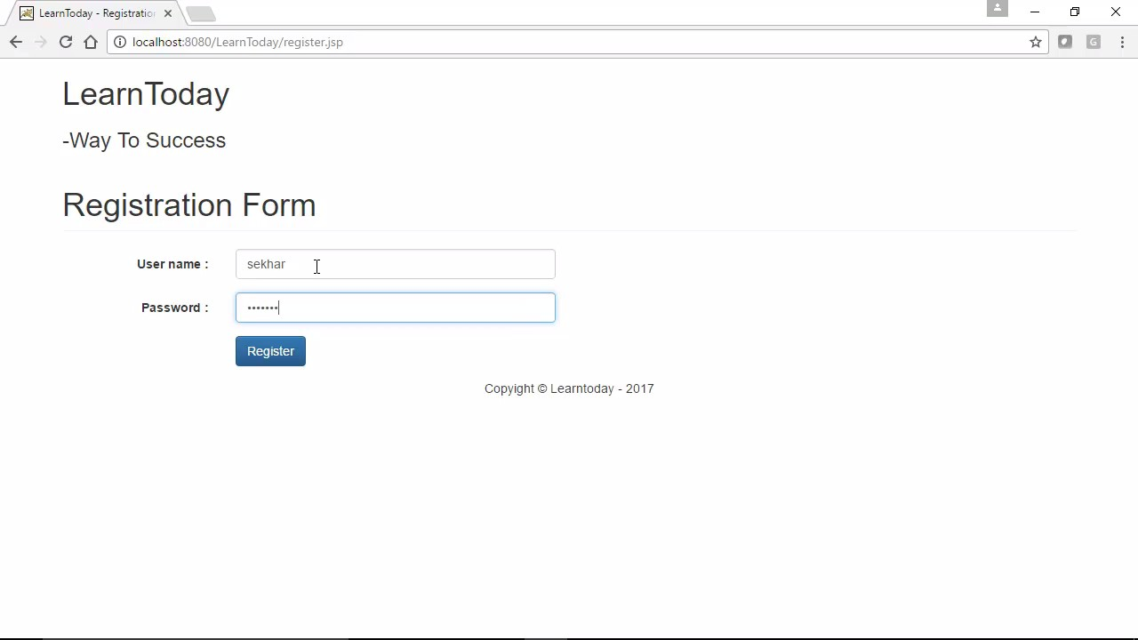

Slide 30
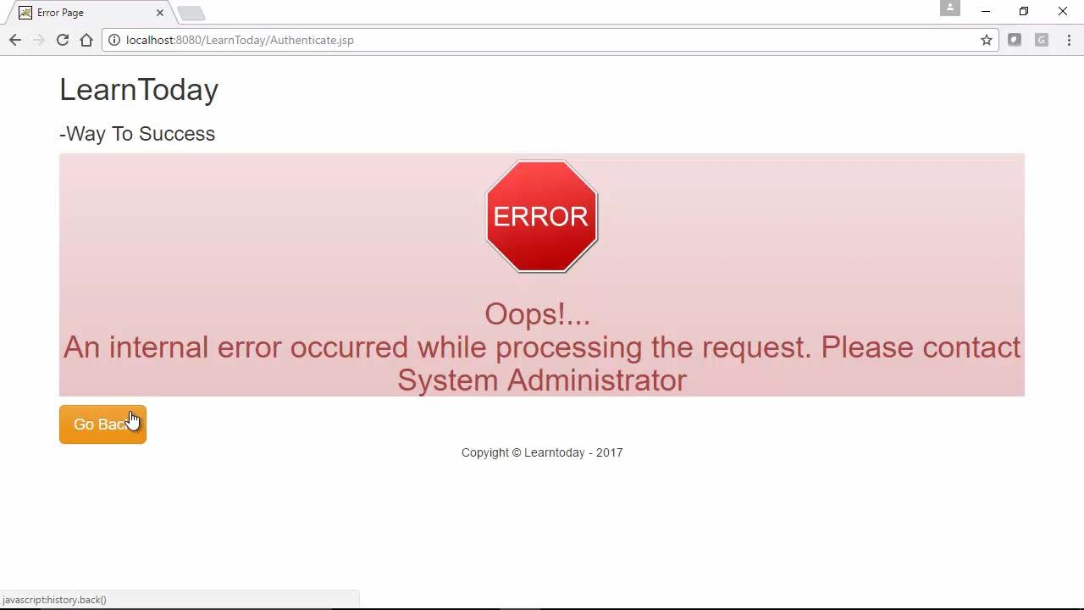

Slide 31


Slide 32


Slide 33
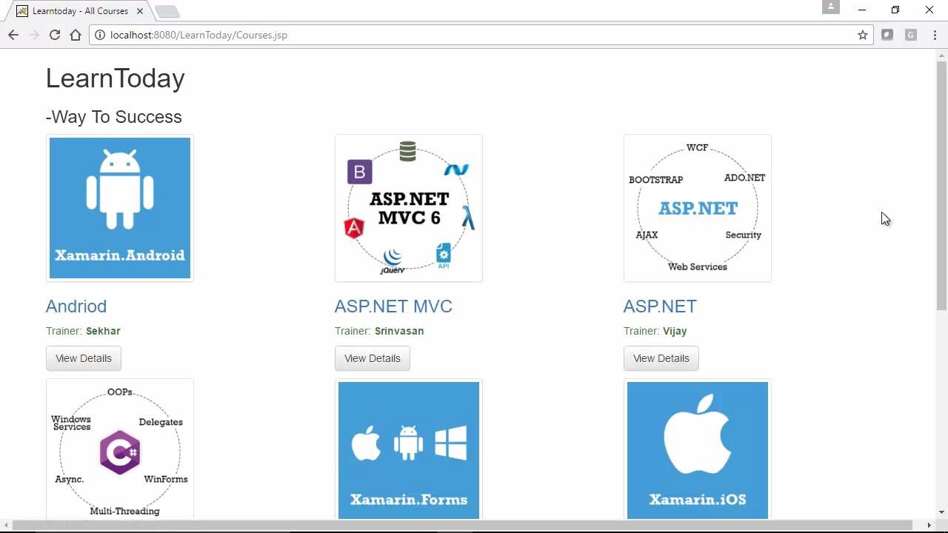

Slide 34
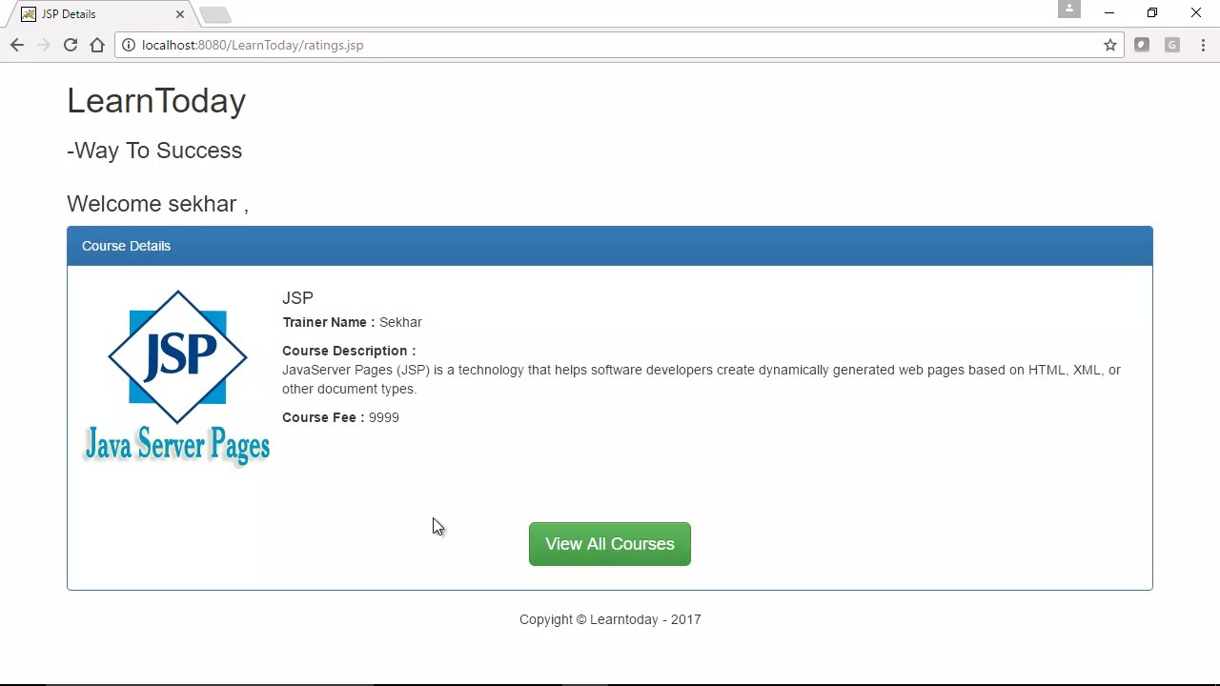

Slide 35
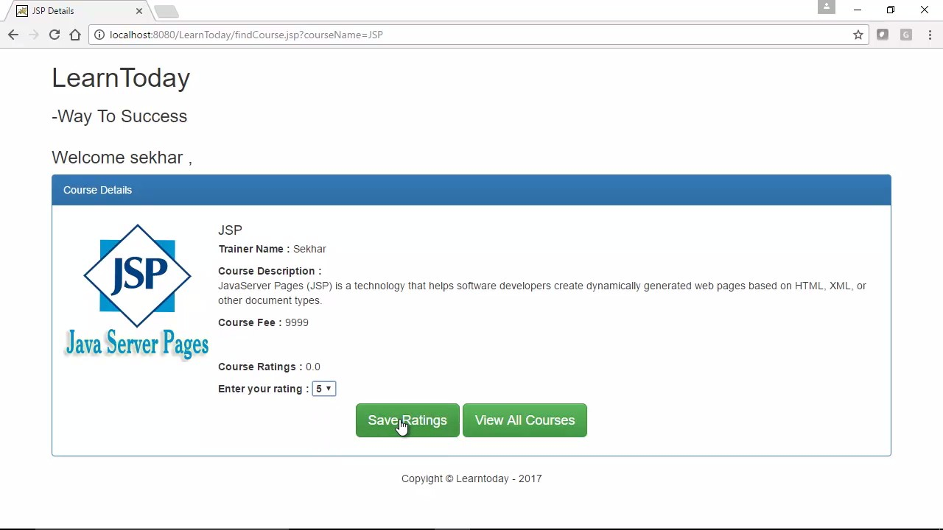

Slide 36
Summary
JSP Life Cycle
JSP Development Models

